Slide 1
Section 3.2
Dividing a Polynomial with a binomial using Long Division and Synthetic Division

Slide 2
I) Review: Dividends, Divisor, Quotients, and Remainders
Ex: Divide the Following Using Long Division
Dividend
Dividend
Divisor:
Divisor
Quotient:
Quotient:
Remainder:
Remainder:
Division Statement:
Dividend = Divisor x (Quotient) + Remainder

Slide 3
Dividing Polynomials
In this section we will look at how to divide a polynomial with a binomial
Overall goal: Next lesson will be about converting a polynomial in general form to factored form [easier to graph]
There are two methods for dividing polynomials:
Method 1: Long Division
  A straight forward process of dividing the remaining leading coefficient with the divisor to find your quotient
  Advantage: Divisor can be a trinomial or any other polynomial
Method 2: Synthetic Division
  A quick method for finding the quotient and remainder by using only the coefficients of the dividend and divisor
  Divisor must be a binomial
  Keep in mind that there are two exceptions in the process!!

Slide 4
Long Division with algebraic Expressions

Slide 5
II) Long Division with Polynomials
Division Statement:

Slide 6
Ex: Use Long Division to divide the following. Find the quotient and remainder.

Slide 7
Practice: Divide Using Long Division & Write the Division Statement
Division Statement:

Slide 11
What is Synthetic Division?
A process for dividing a polynomial with a divisor by using only the coefficients
First rearrange the terms in the dividend so that they are in descending order by degree
Write the coefficients in the upper row of inside a box
Make the divisor equal to zero and solve for “x”
Take the coefficients of your dividend:
Rules: Go down you ADD, Diagonal You multiply with the divisor!
Place the divisor in front:
Quotient: The other three terms are used for creating the Quotient
REMAINDER: The last number on the right is the remainder!

Slide 12
III) Synthetic Division:
Synthetic Division is an alternative to Long Division:
Used for dividing polynomials
Take the coefficients of your dividend:
Place the divisor in front:

Slide 13
Practice: Divide the following using synthetic division. Find the remainder and quotient. Show all your work and steps

Slide 14
Practice:
Take the coefficients of your dividend:
Place the divisor in front:

Slide 15
Two REMINDERS with Synthetic Division
REMINDER #1: (Missing terms in Dividend)
i)If the Dividend is missing a term (ie: skipping from x³ to x¹, no x² term) then replace missing term x² with a coefficient of zero

Slide 16
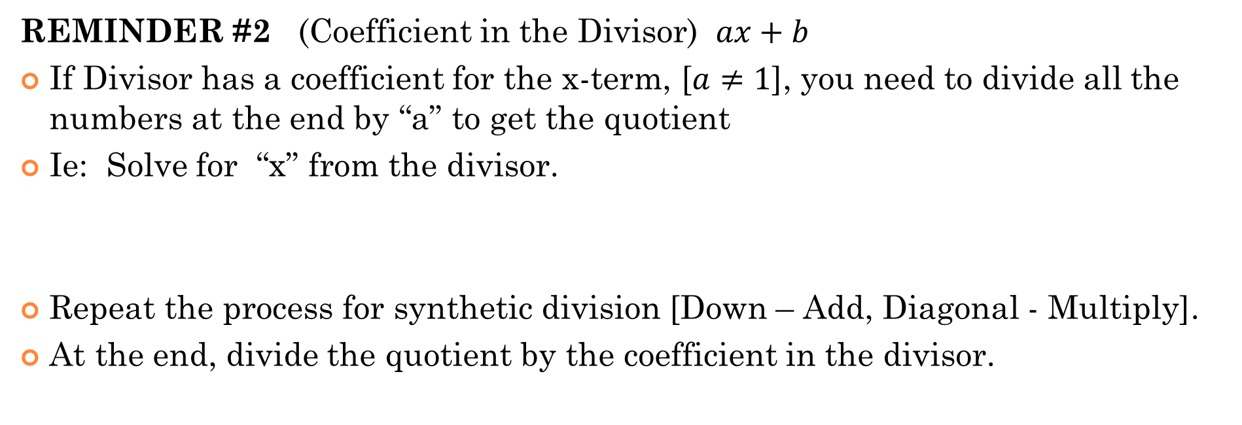
REMINDER #2 (Coefficient in the Divisor) $ax+b$
If Divisor has a coefficient for the x-term, [$a≠1$], you need to divide all the numbers at the end by “a” to get the quotient
Ie: Solve for “x” from the divisor.
Repeat the process for synthetic division [Down – Add, Diagonal - Multiply].
At the end, divide the quotient by the coefficient in the divisor.
Divide All these THREE numbers by 2 to get the quotient!

Slide 17
Practice: Use synthetic division to divide the following. Find the quotient and remainder:

Slide 18
Practice:
Take the coefficients of your dividend:
Place the divisor in front:
For the Quotient, divide all the coefficients by 2

